Slide 1
Citra | Pesan (karakter) | Pixel | Size (KB) | Waktu (detik) | Hasil
lena_gray | 114 | 512 x 512 | 257 |  | Gagal
 | 786 | 512 x 512 | 257 |  | Gagal
 | 4415 | 512 x 512 | 257 |  | Gagal
lena | 114 | 128 x 128 | 48 | 1 | Berhasil
 | 786 | 128 x 128 | 48 | 2.63 | Berhasil
 | 4415 | 128 x 128 | 48 | 20.56 | Berhasil
 | > 6096 | 128 x 128 | 48 |  | Gagal
amelia | 114 | 1576 x 2364 | 10600 | 1.6 | Berhasil
 | 786 | 1576 x 2364 | 10600 | 2.82 | Berhasil
 | 8832 | 1576 x 2364 | 10600 | 67.46 | Berhasil
 | > 1396533 | 1576 x 2364 | 10600 |  | Gagal

Slide 2
Citra | Pesan (karakter) | Pixel | Size (KB) | Waktu (detik) | Hasil
lena_gray | 114 |  |  |  | Gagal
 | 786 |  |  |  | Gagal
 | 4415 |  |  |  | Gagal
lena | 114 | 128 x 128 | 48 | 1 | Berhasil
 | 786 | 128 x 128 | 48 | 3.4 | Berhasil
 | 4415 | 128 x 128 | 48 | 36 | Berhasil
amelia | 114 | 1576 x 2364 | 10600 | 1.3 | Berhasil
 | 786 | 1576 x 2364 | 10600 | 3.76 | Berhasil
 | 8832 | 1576 x 2364 | 10600 | 144.26 | Berhasil

Slide 3
Citra | Pixel | Size (KB) | Kapasitas Karakter Maksimal Pesan
lena_gray | 512 x 512 | 257 | 98112
lena | 128 x 128 | 48 | 6096
amelia | 1576 x 2364 | 10600 | 1396533

Slide 4
Citra | Bit | Pixel | Hasil
lena_gray | 8 | 512 x 512 | Gagal
lena | 24 | 128 x 128 | Berhasil
amelia | 32 | 1576 x 2364 | Berhasil

Slide 5
Citra | Pixel Sebelum | Pixel Sesudah | Size (KB) | Hasil
lena | 128 x 128 | 128 x 97 | 36.4 | Gagal
amelia | 1576 x 2364 | 480 x 494 | 694 | Gagal

Slide 6
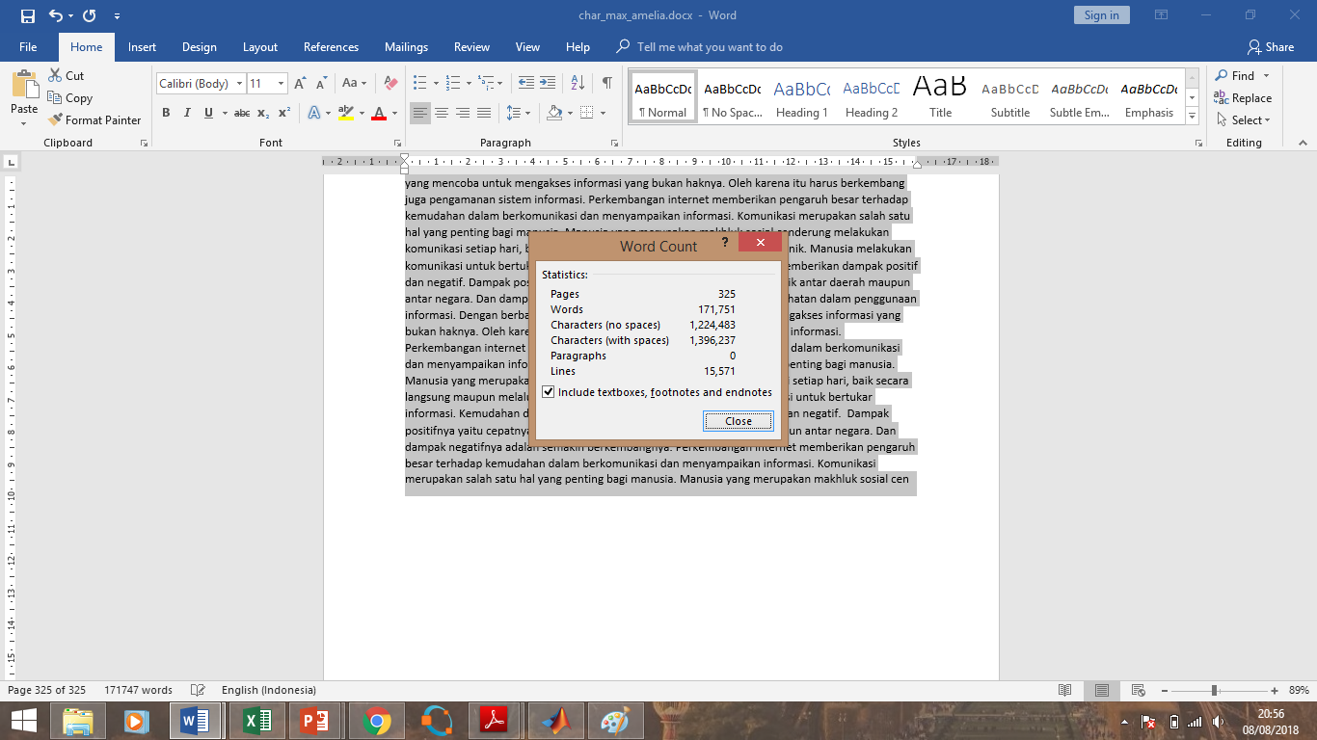

Slide 7
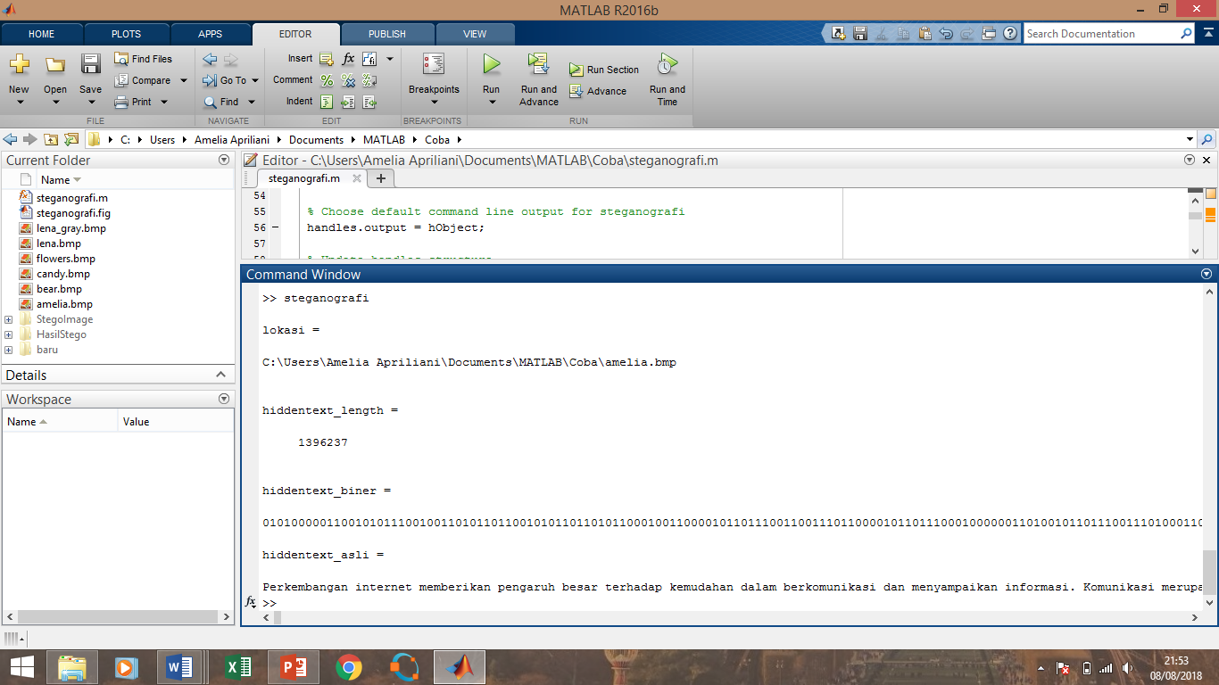

Slide 8
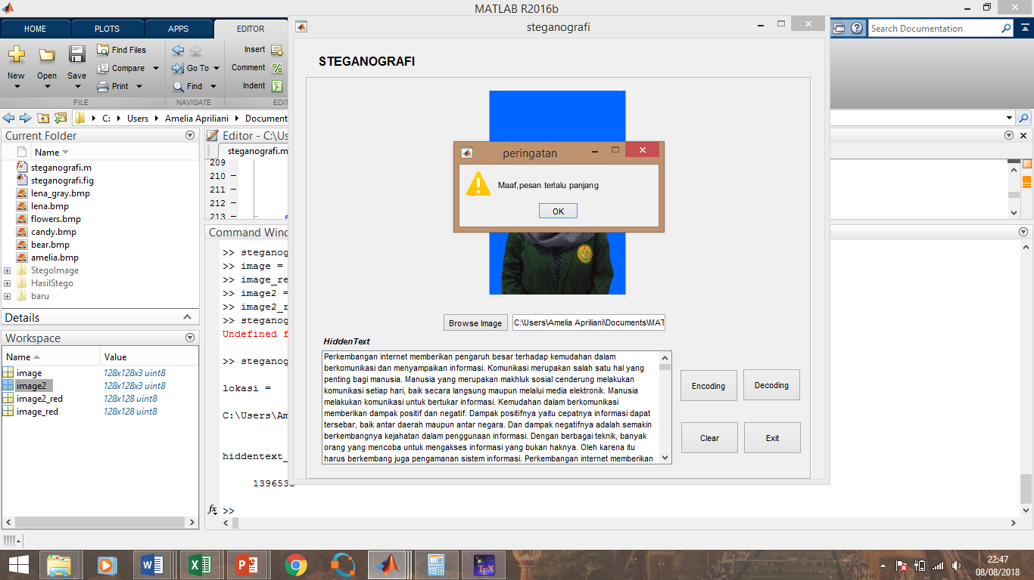

Slide 9
